Slide 1

OS Lab 10
Instructor
Saba Naseem
saba.naseem@nu.edu.pk

Slide 2
Mutexes
A mutex is a mutual exclusion lock:
Block access to variables by other threads.
Enforces exclusive access by a thread to a shared resource.
Can protect a “critical” section of memory.
Mutexes can be applied to threads in a single process and do not work between processes

Slide 3
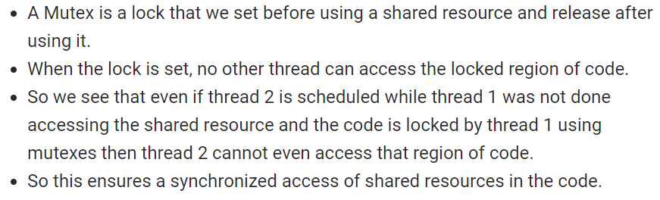

Slide 4
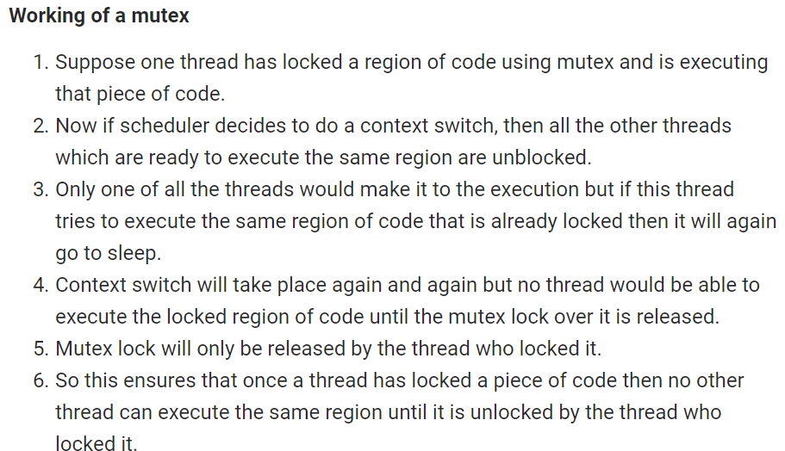

Slide 5
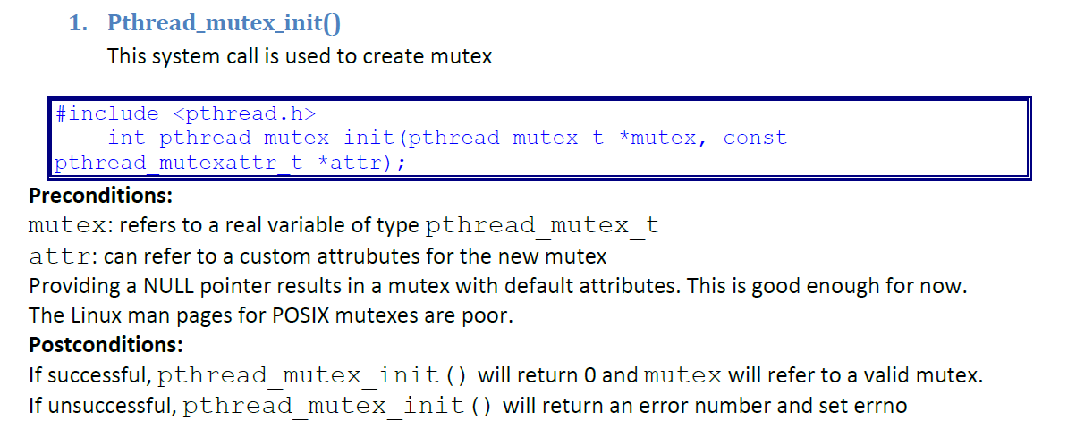

Slide 6
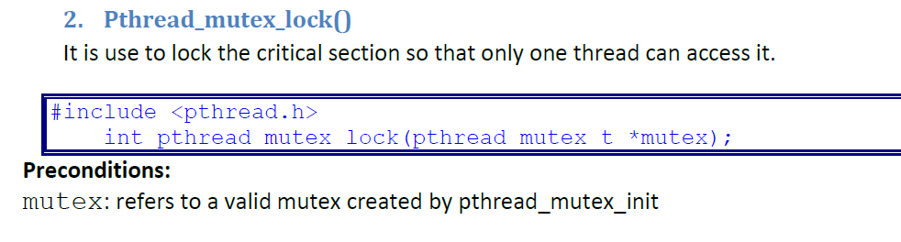
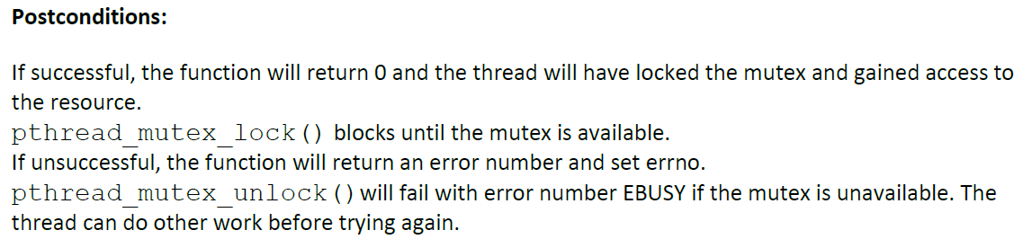

Slide 7
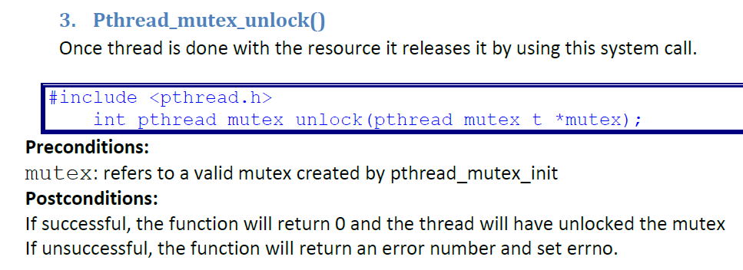

Slide 8
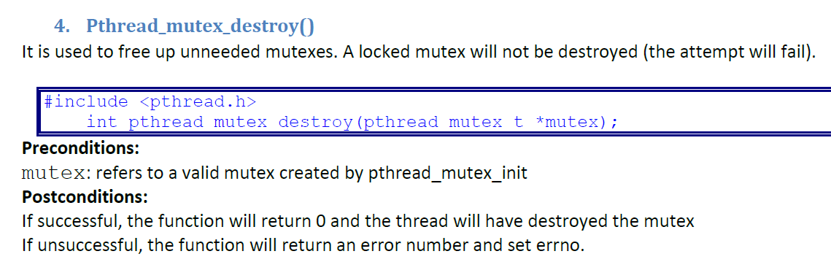

Slide 9
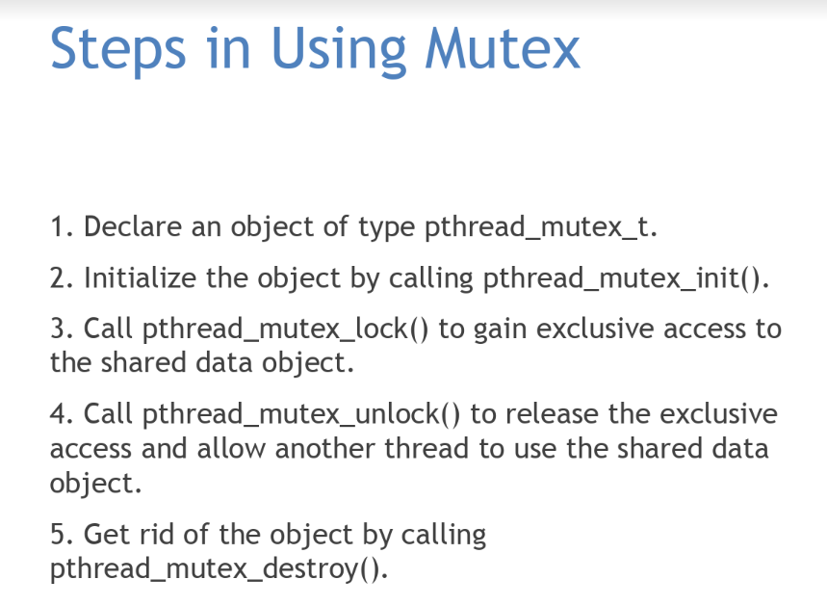

Slide 10
Condition Variables
The condition variable mechanism allows threads to suspend execution and relinquish the processor until some condition is true.
A condition variable must always be associated with a mutex to avoid a race condition created by one thread preparing to wait and another thread which is preparing to change the truth value of the condition.
There is no explicit link between the mutex and the condition variable.

Slide 11
Basic condition variable functions
Declaring a condition variable:
pthread_cond_init(pthread_cond_t *cond, const pthread_condattr_t *attr);
Destroying a condition variable:
pthread_cond_destroy(pthread_cond_t *cond);

Slide 12
Using a condition variable
Waiting on condition:
pthread_cond_wait(pthread_cond_t *cond,pthread_mutex_t *mutex); - unlocks the mutex and waits for the condition variable cond to be signaled.
Waking thread based on condition:
pthread_cond_signal(pthread_cond_t *cond); - restarts one of the threads that are waiting on the condition variable cond.
pthread_cond_broadcast(pthread_cond_t *cond); - wake up all threads blocked by the specified condition variable.

Slide 13
Interaction of condition variables in threads
Thread X
Acquires mutex A
Checks condition (T or F)
False – mutex A released atomically & thread X suspended
4) …
Thread reaquires mutex A (repeat
if false)
True – proceed with execution of critical section
Thread finishes critical section and releases mutex A
Thread continues its instructions
Thread Y
Acquires mutex A
It modifies the state of the condition
Signal message to unblock X (and any other threads)
Thread releases mutex A
Thread continues its instructions

Slide 14
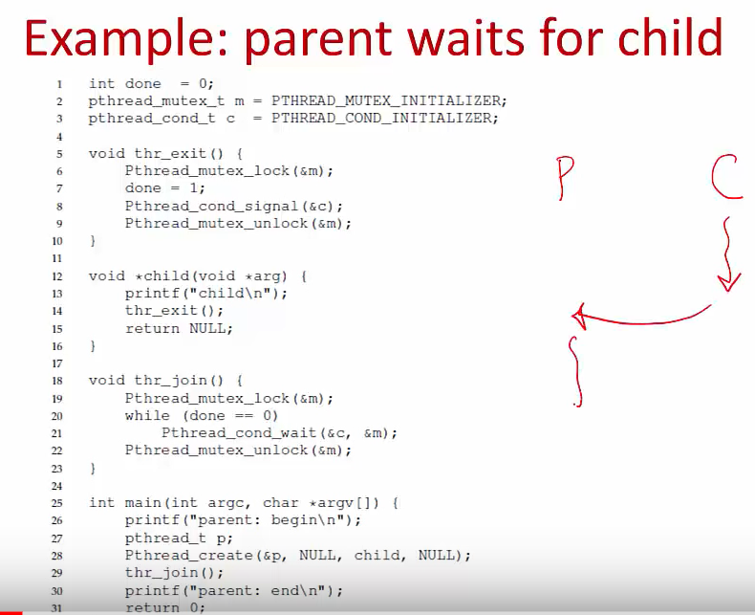

Slide 15
Semaphore
Semaphore is a process synchronization tool.
Semaphore is typically an integer variable S that is initialized to the number of resources present in the system and the value of semaphore can be modified only by two functions wait() and signal() apart from initialization.
Counting semaphores and Binary semaphore.
In Counting Semaphore, the semaphore S value is initialized to the number of resources present in the system.
In Binary semaphore, the value of semaphore ranges between 0 and 1.

Slide 16
Posix semaphores
All POSIX semaphore functions and types are defined in semaphore.h. To define a semaphore object, use
#include <semaphore.h> sem_t sem_name;
To initialize a semaphore, use sem_init():
int sem_init(sem_t *sem, int pshared, unsigned int value);
sem points to a semaphore object to initialize
pshared is a flag indicating whether or not the semaphore should be shared with a process related by a common ancestor and using shared memory.
value is the initial value assigned to the semaphore
●
●
●
Example of use:
sem_init(&sem_name, 0, 10);
The value of pshared is 0, so the semaphore is known only in this process.

Slide 17
Using semaphores
A thread can have exclusive access to a semaphore (binary semaphore) or several threads can be accessing the semaphore (counting semaphore). The programmer decides the usage by the appropriate use of sem_wait() and sem_post().
To access or obtain a semaphore, int sem_wait(sem_t *sem);
Example of use: sem_wait(&sem_name);
●
This function decrements the value of the semaphore.
If the value of the semaphore is negative, the calling thread blocks until another thread increments the value.
●

Slide 18
To increment the value of a semaphore, use sem_post():
int sem_post(sem_t *sem); Example of use:
sem_post(&sem_name);
The function increments the value of the semaphore and wakes up any blocked thread that is waiting on the semaphore.
Any thread can issue a call to sem_post() and is issued when the thread is done with a critical section of code or no longer needs exclusive access to a shared variable or resource.

Slide 19
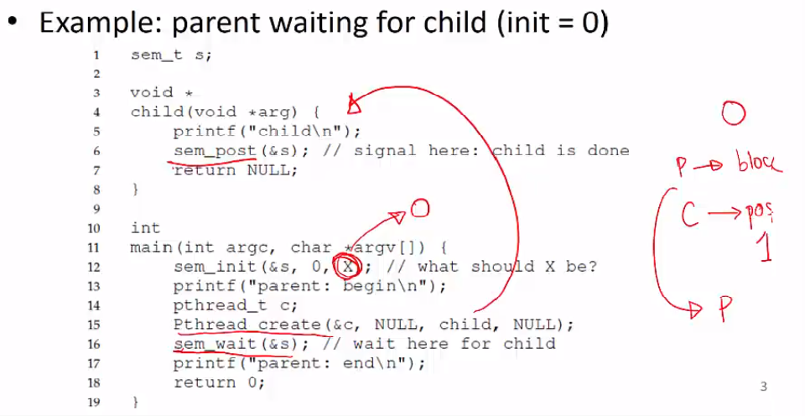

Slide 20
To find out the value of a semaphore, use
int sem_getvalue(sem_t *sem, int *valp);
The current value of sem is placed in the location pointed to by valp. Example of use:
int value; sem_getvalue(&sem_name, &value);
printf("The value of the semaphore is %d\n", value);
To destroy a semaphore, use
int sem_destroy(sem_t *sem);
No threads should be waiting on the semaphore or it will not be destroyed. Example of use:
sem_destroy(&sem_name);

